Slide 1
Problems on Chapter-1

Slide 2
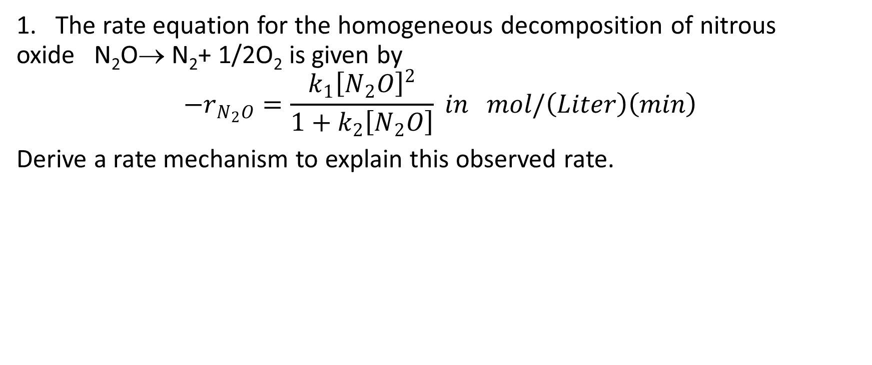
Problems:
1. The rate equation for the homogeneous decomposition of nitrous oxide N₂O→ N₂+ 1/2O₂ is given by
$$−r_{N_{2}O}=\frac{k_{1}{\left[N_{2}O\right]}^{2}}{1+k_{2}\left[N_{2}O\right]} in mol/\left(Liter\right)\left(min\right)$$
Derive a rate mechanism to explain this observed rate.

Slide 3
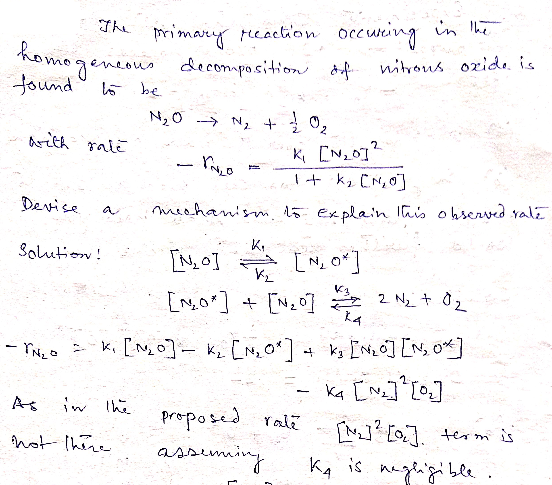

Slide 4
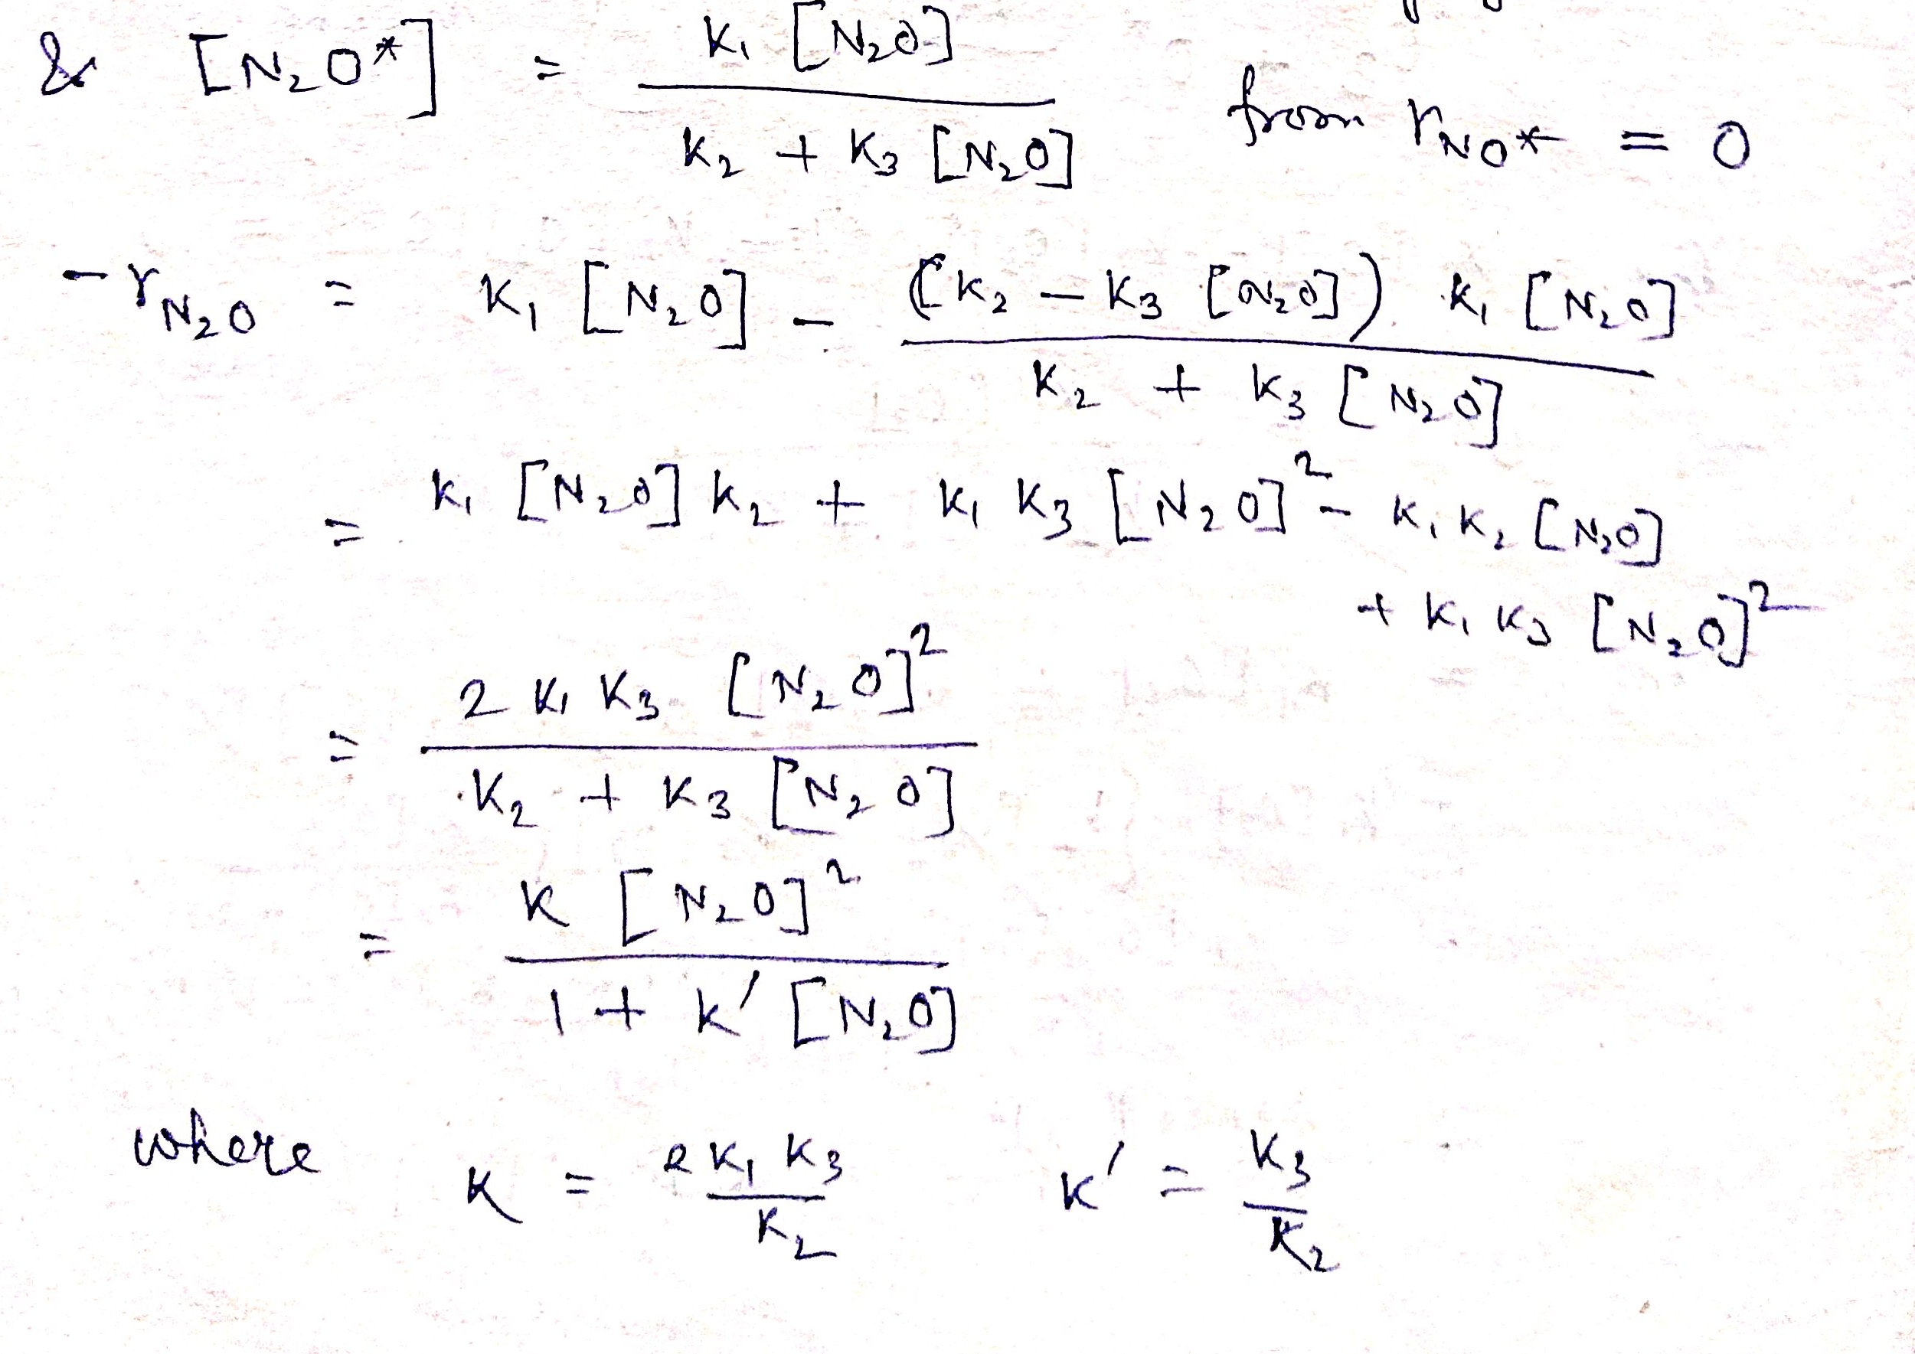

Slide 5
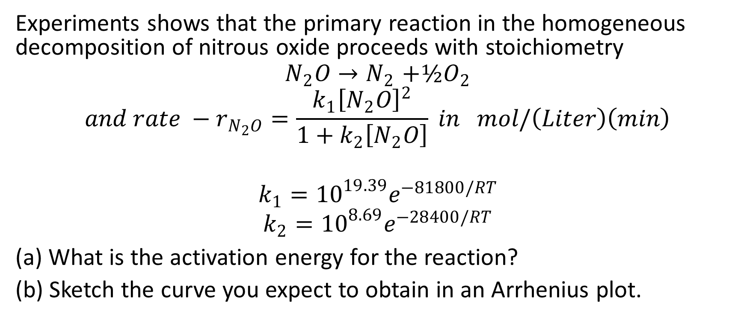
Problem-2
Experiments shows that the primary reaction in the homogeneous decomposition of nitrous oxide proceeds with stoichiometry
$$N_{2}O{→N}_{2}+½O_{2}$$
$$and rate −r_{N_{2}O}=\frac{k_{1}{\left[N_{2}O\right]}^{2}}{1+k_{2}\left[N_{2}O\right]} in mol/\left(Liter\right)\left(min\right)$$
$$k_{1}={10}^{19.39}e^{−81800/RT}$$
$$k_{2}={10}^{8.69}e^{−28400/RT}$$
(a) What is the activation energy for the reaction?
(b) Sketch the curve you expect to obtain in an Arrhenius plot.

Slide 6
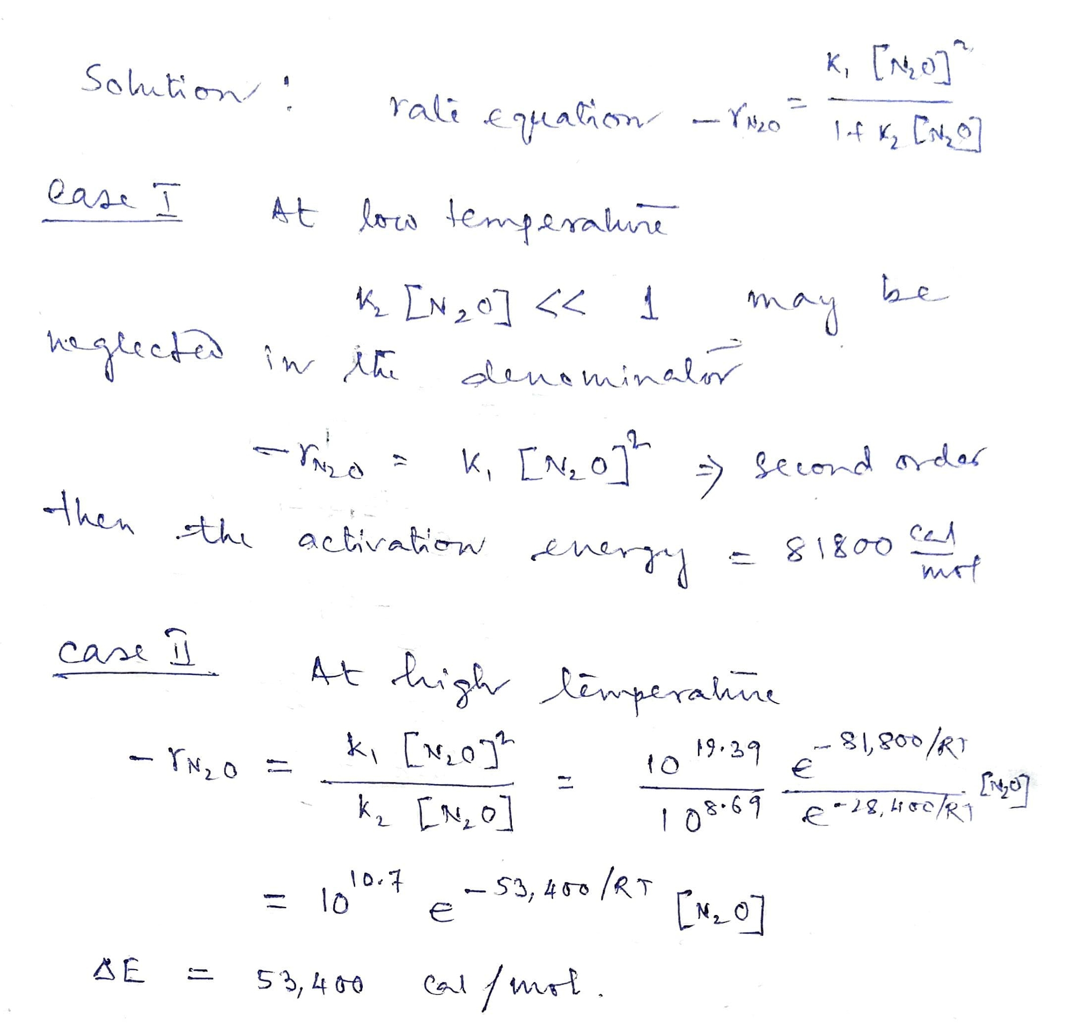

Slide 7
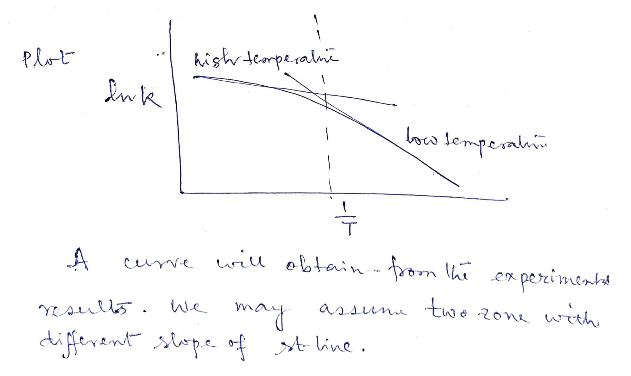

Slide 8
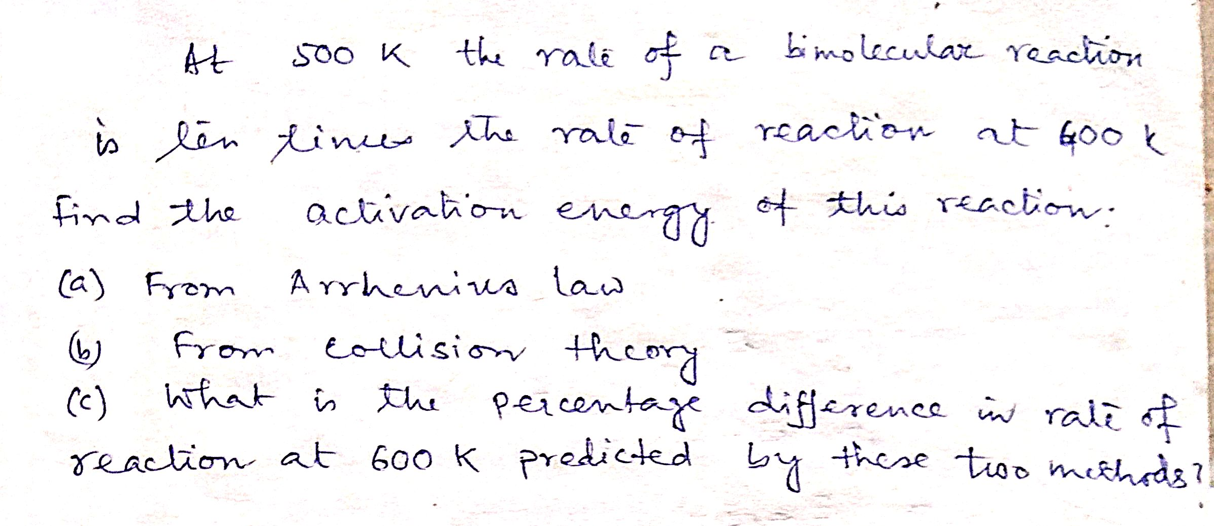
Problem-3

Slide 9
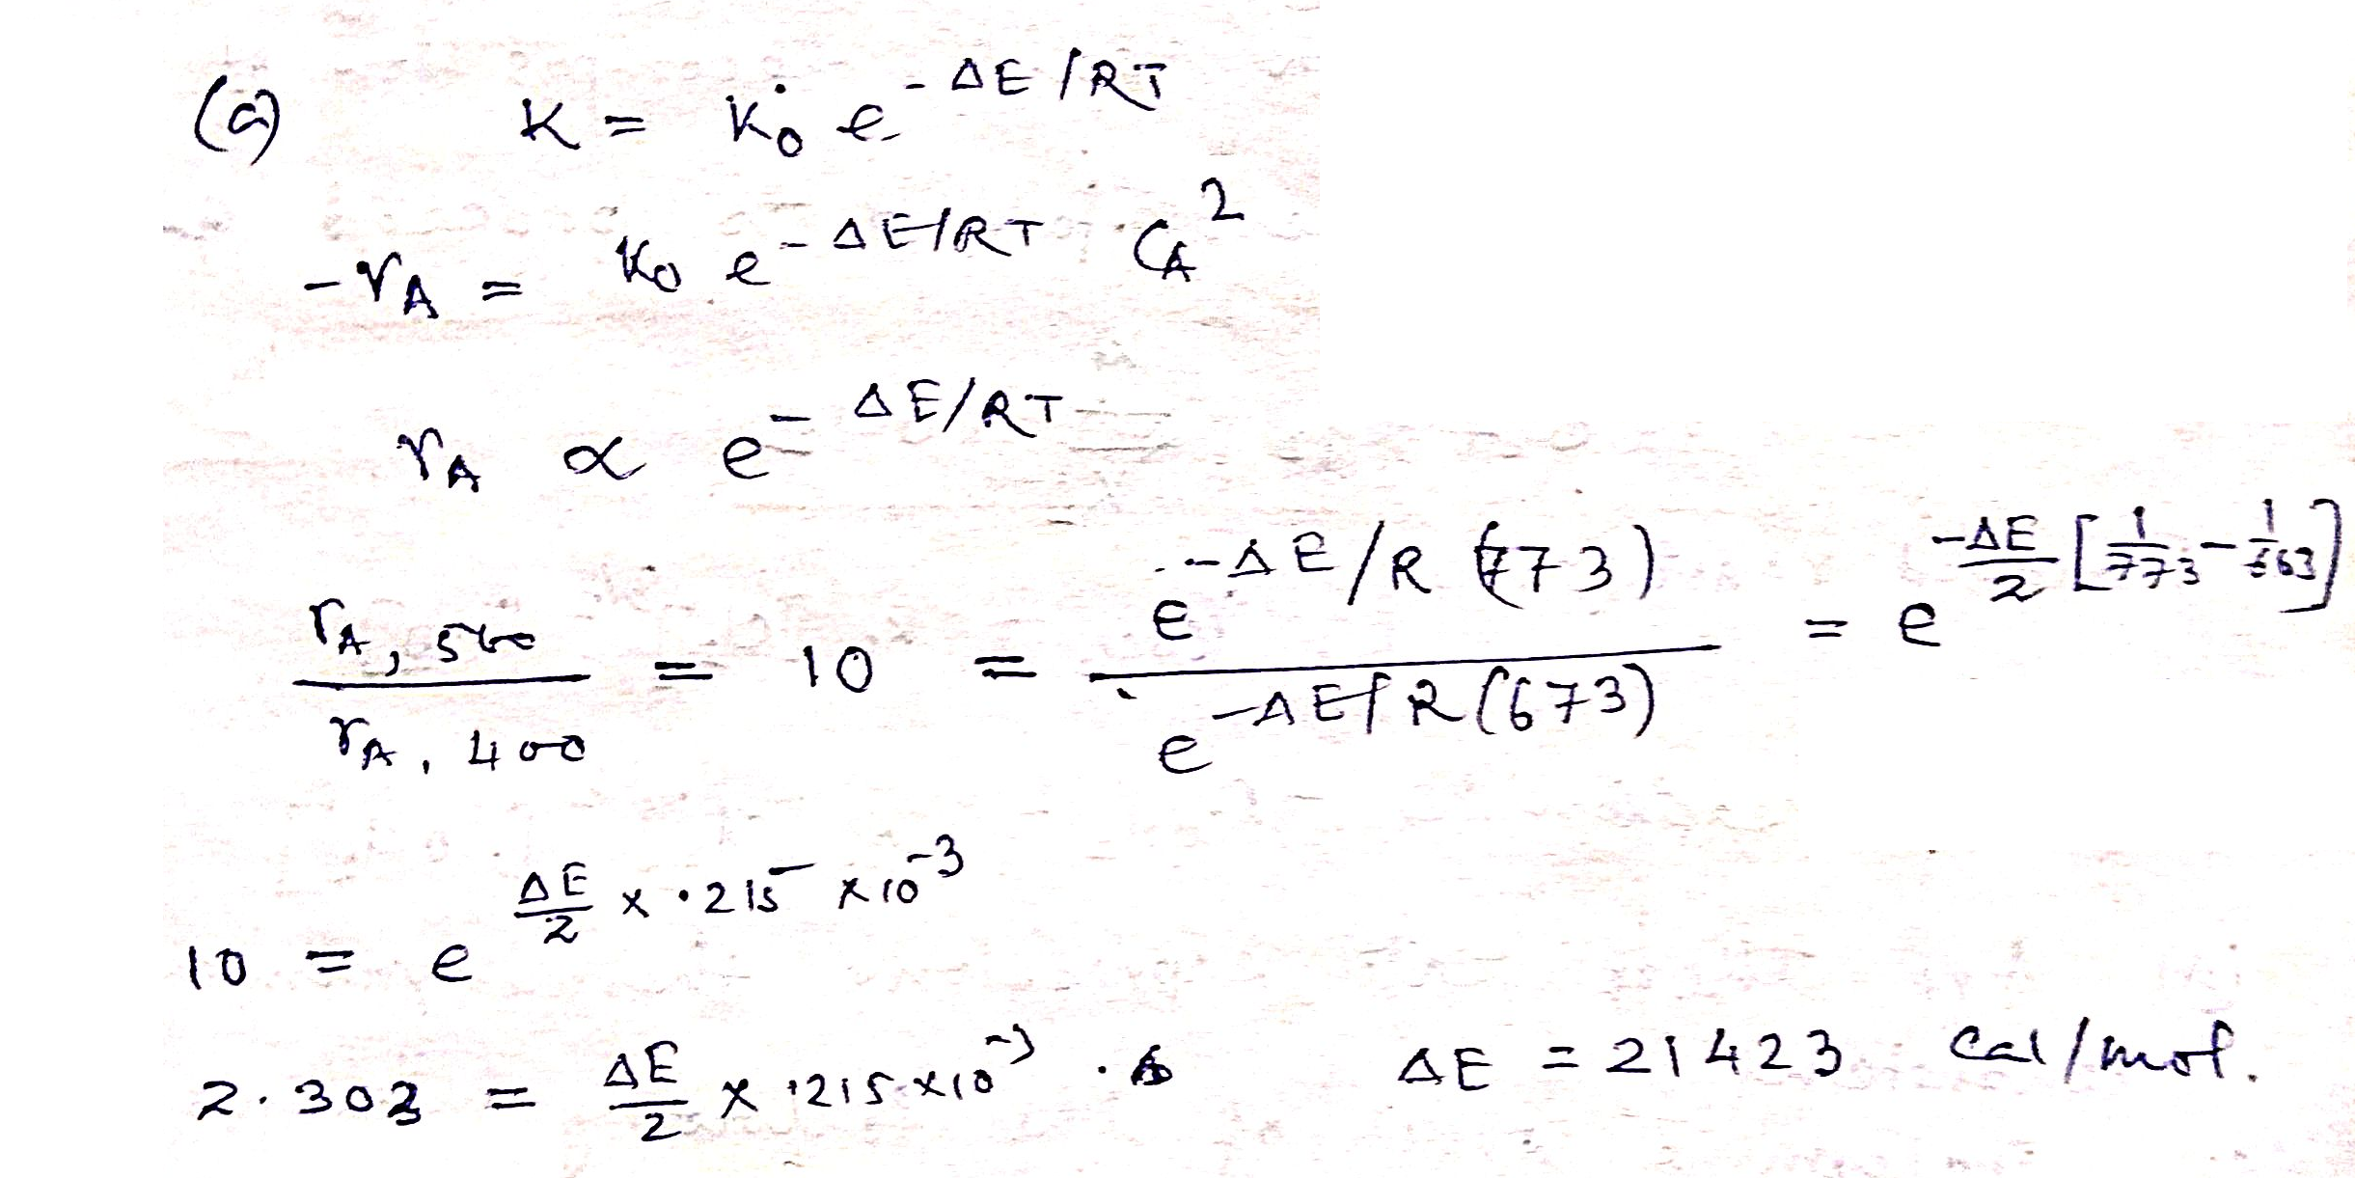
Solution:

Slide 10
